Slide 1
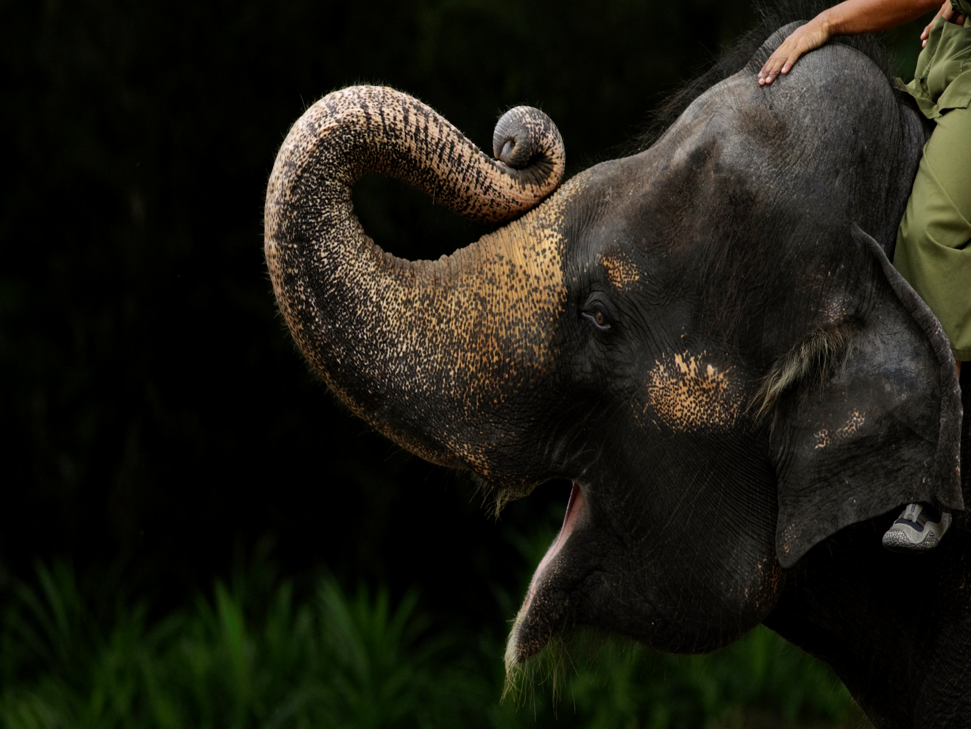
Thanks to Shiba the elephant wars
By: Alaira Florez

Slide 2
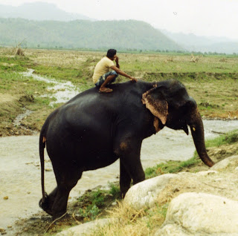
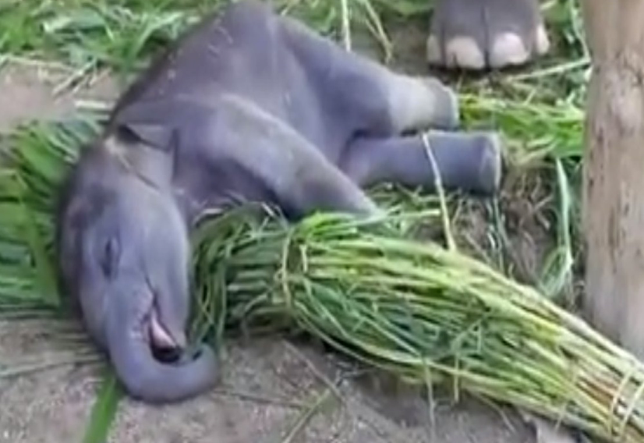
The Beginning CHAPTER 1
I was young when my best friend for life came into the world. It was early mourning before the sun rose that stormy night in the spring. My father’s favorite elephant, Raja, was having her first calf. I woke up to sounds of trumpeting elephants, I quickly went outside to aid them to find tired Raja, my father… and a little elephant. My father pointed and said, “Shiba.”
Father said that Raja’s calf would be my elephant before Shiba was born. However this should have been a grand moment for me but I was just stuck as I looked at little Shiba. I went to pet her and then, her trunk met my hand. That is when I knew that we would always stay together.
I couldn’t be more happy for Raja, not only was she my father’s favor when it comes to elephants she was also a good friend of mine. Raja would often let me ride on her back, bathe her, pet her, and it was her kind nature that brought us together.

Slide 3
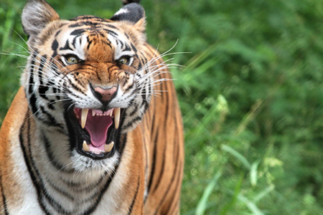
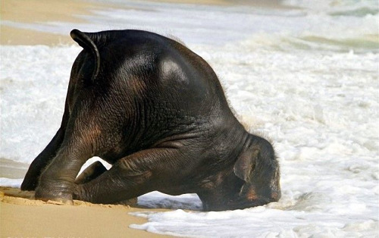
Little Shiba chapter 2
Growing up Shiba was the most curious creature I have ever known not to mention the most humorous! When Shiba was two weeks old she ran into the jungle next to our home, then there was a ear shattering cry and then a thundering roar. First came Shiba then came… The tiger! I quickly grabbed a big branch and stood between the furious cat and my poor baby elephant. One bite and my branch shattered then when I lost all hope, Raja came in to save us with a loud trumpet and a few scratches the tiger became a coward and ran into the forest!
After that however young Shiba didn’t learn, once I took her on her first bath. She tripped and went head first into the river bed, she stayed there for a bit. When she came back up, her entire trunk was covered in mud!

Slide 4
Kindness of a Mother chapter 3
One gloomy and rainy mourning Shiba and Raja went missing, it was the season of flooding too. “Shiba, Raja? Where are you?” With great fear and worry I ran into the jungle. I heard the sound of Raja’s loud cry. “Raja!” when I came to the river bank I saw it was flooding fast and very muddy. Raja was locked trunk to trunk with Shiba, who was covered in mud. Right before I could go in to save my elephant, Raja rushed into the muck! She managed to get her baby out of the death trap, with great sacrifice. She was stuck with all her weight causing her to sink in the mud.
“Raja get out of there!” I screamed. However it seemed like she was in a whole other world as she nuzzled Shiba’s face with her trunk with the gentleness of a mother’s touch. We waited for her to pass on, I felt that she should feel loved in her last moments. After dark I held tight to my little Shiba and we both cried to sleep on the river bank.
The next mourning we reluctantly walked home and I told my father of the passing of Raja. He shattered and cried, and so did I when I laid by Shiba in the stable she once shared with her gracious and kind, loving mother.

Slide 5
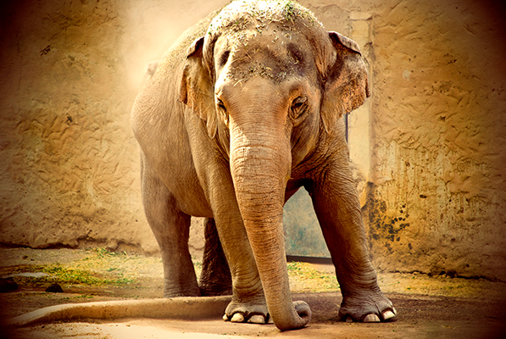
Losing Shiba chapter 4
It was years after losing Raja when I left for a great war I have always enjoyed helping my people, I also enjoyed working with elephants. It turns out that is what I can do if I join in on this great battle. I rushed to say goodbye to my family and then I ran to say goodbye to my best friend, Shiba who was now all grown up. I knew I could never truly say goodbye so I took her out of her stable and walked with her to a new riverbank. Ever since Raja I could never bring myself to go to that riverbank again. So I talked to her as she soaked in the water, and something told me she understood because
I could sense a hint of sadness.
On the way home she let me
Ride on her back for the very first time it was
Like magic as we swayed side to side on the
trail home. I finally got off her back walked
away. Only to find her trailing behind “No
Shiba! No!” my elephant looked hurt when I
scolded her, for I have never done that. I pet
her and told her I was sorry then went on my
way to war.

Slide 6
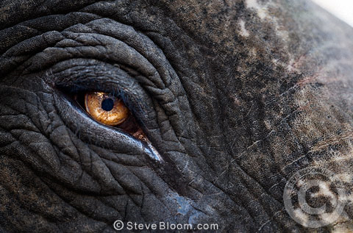
Shiba chapter 5
Battle was to begin shortly and I was ready to go I got on my assigned elephant and started riding. There I was at long last fighting for my life! The rest of the men who were riding with me got shot down so it was me, this elephant, and my weapon. As I fought on I saw our leader Asoka battling bravely. This made me try my best to win, but then, I was shot off the elephant wounded I heard an all too familiar sound. It was Shiba rushing to my aid I was shot with an arrow in my leg and couldn’t move.
She stood over me like a mother would her calf and fought off any soldier that tried to attack. I looked around and saw many elephants doing the same only, their masters were dead. Then we were surrounded they started attacking Shiba to get to me I fired my arrow at our attackers finally the dust cleared and we emerged victorious I was alive to witness this victory. Thanks to Shiba for saving my life. I got on her and we rode home. On the way I saw the distressed elephants and felt very bad as they stayed with their deceased masters.
I was happy as could be until Shiba stopped. “Shiba?” I got off and looked at her, there were three arrows in her stomach. “Shiba!” I quickly and carefully took them out. We stopped to rest as I healed her wounds. After words we made it home and the elephant wars concluded.

Slide 7
THE END

